Slide 1

CERTIFICATE III IN AUTOMOTIVE REPAIR & MAINTENANCE
SUBJECT: VEHICLE MAINTENACE AND REPAIR
By Ibrahim siraj
Maldives polytechnic

Slide 2
VEHICLE MAINTENACE AND REPAIR
Chapter 16 Inspect and Service Suspension System
Key function
Ride comfort: It absorbs and dampens the vibrations and impacts from uneven road surfaces, preventing the entire vehicle from bouncing uncontrollably.
Tire contact: It keeps the tires firmly on the road, which is essential for a stable and safe driving experience.
Handling and control: By controlling the vehicle's body movements, it allows for better steering, cornering, and overall handling.
Vehicle support: It supports the weight of the car and helps maintain a consistent ride heigh
By Ibrahim siraj
Maldives polytechnic

Slide 3
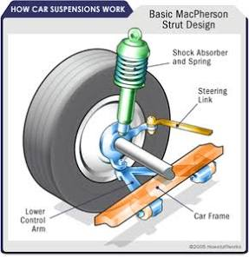
VEHICLE MAINTENACE AND REPAIR
Chapter 16 Suspension system
Main components
1 Springs:
2 Shock Absorbers (Dampers)
3 Struts
4 Control Arms (Wishbones)
5 Sway Bars (Anti-roll bars)
6 Ball Joints and Bushings
By Ibrahim siraj
Maldives polytechnic

Slide 4
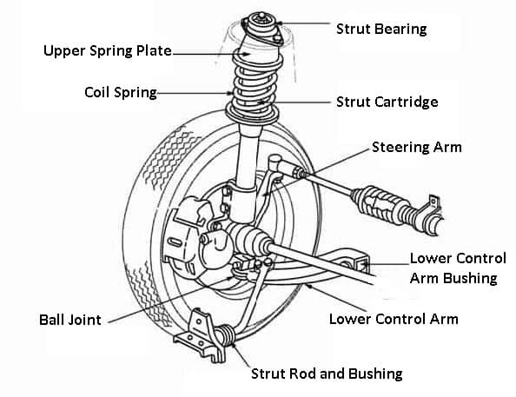
VEHICLE MAINTENACE AND REPAIR
Chapter 16 Suspension system
Main components
1 Springs: These support the vehicle's weight and absorb initial impacts.
Common types include coil, leaf, and torsion bar springs.
By Ibrahim siraj
Maldives polytechnic

Slide 5
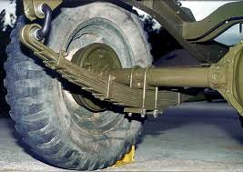
VEHICLE MAINTENACE AND REPAIR
Chapter 16 Suspension system
Main components
1 Springs: These support the vehicle's weight and absorb initial impacts.
Leaf spring
Multiple layers of steel strips (leaves) stacked in an arc shape that bend to absorb impacts
Heavy-duty trucks, commercial vehicles, buses, and older vehicles due to their high load capacity and durability.
By Ibrahim siraj
Maldives polytechnic

Slide 6
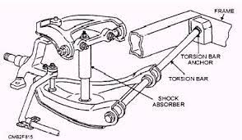
VEHICLE MAINTENACE AND REPAIR
Chapter 16 Suspension system
Main components
Torsion Bar
Straight rods of spring steel that twist along their axis to provide spring action. Their height is often adjustable.
Some SUVs, off-road vehicles, and military vehicles; can also be found in older European and American cars
By Ibrahim siraj
Maldives polytechnic

Slide 7
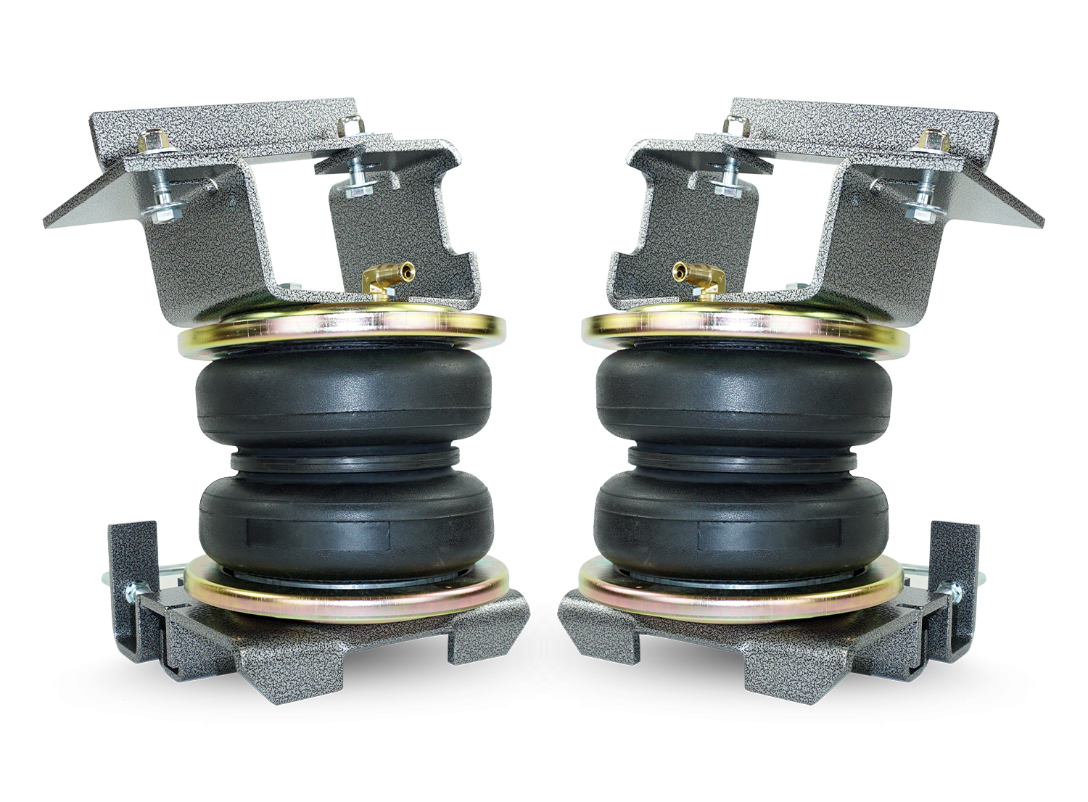
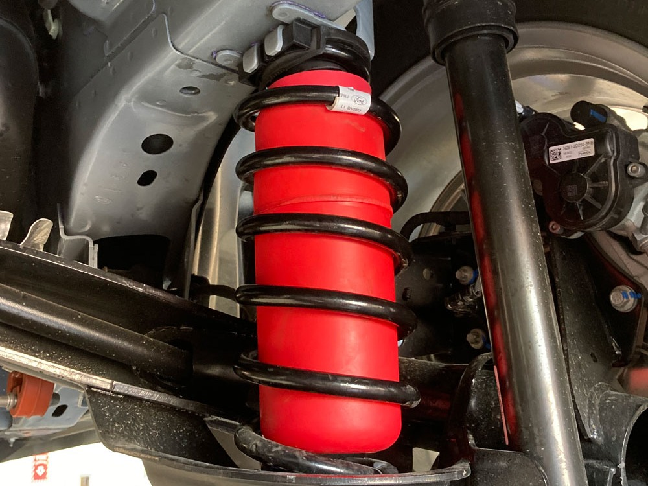
VEHICLE MAINTENACE AND REPAIR
Chapter 16 Suspension system
Main components
Air Spring
Tough rubber or plastic bladders filled with compressed air that can be inflated or deflated to adjust vehicle height and load capacity
Luxury vehicles, buses, and commercial trucks that require self-leveling and enhanced ride comfort
By Ibrahim siraj
Maldives polytechnic

Slide 8
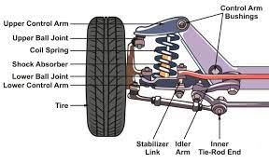
VEHICLE MAINTENACE AND REPAIR
Chapter 16 Suspension system
Main components
Shock Absorbers (Dampers): These hydraulic devices convert the kinetic energy of spring movement into heat, dissipating it and preventing the car from bouncing uncontrollably.
By Ibrahim siraj
Maldives polytechnic

Slide 9
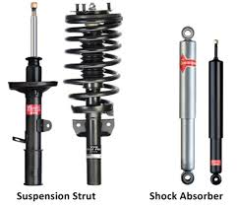
VEHICLE MAINTENACE AND REPAIR
Chapter 16 Suspension system
Main components
Struts: A strut is an assembly that combines a coil spring and a shock absorber into a single structural unit, commonly used in modern passenger vehicles.
By Ibrahim siraj
Maldives polytechnic

Slide 10
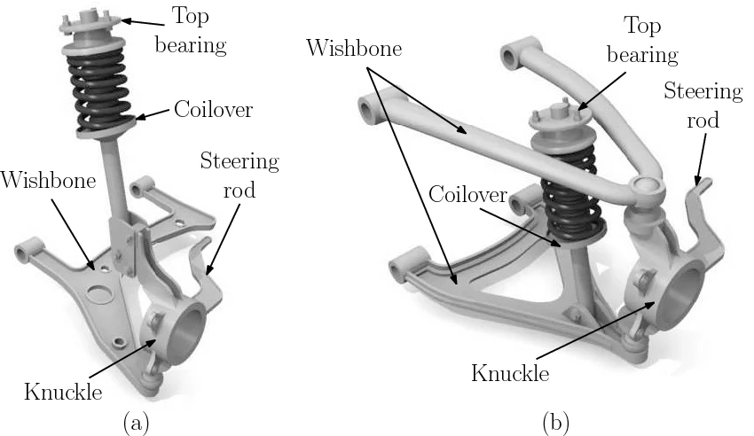
VEHICLE MAINTENACE AND REPAIR
Chapter 16 Suspension system
Main components
Control Arms (Wishbones): These movable links connect the steering knuckle/wheel hub to the vehicle's frame, guiding the wheels' up-and-down motion and maintaining proper alignment.
By Ibrahim siraj
Maldives polytechnic

Slide 11
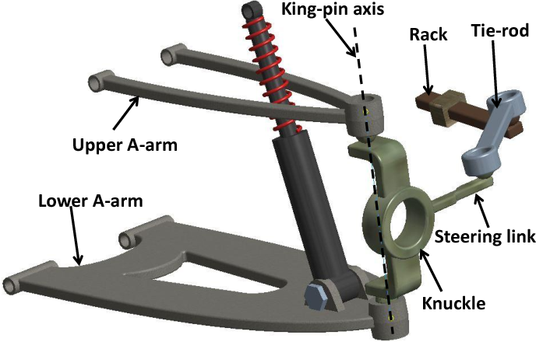
VEHICLE MAINTENACE AND REPAIR
Chapter 16 Suspension system
Single Wishbone (MacPherson Strut) Suspension
Double Wishbone Suspension
The most common single wishbone implementation is the MacPherson strut, which uses a single lower control arm (wishbone) and a combined shock absorber/spring assembly that also serves as a steering pivot.
By Ibrahim siraj
Maldives polytechnic

Slide 12
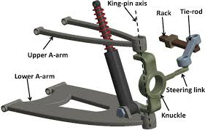
VEHICLE MAINTENACE AND REPAIR
Chapter 16 Suspension system
Single Wishbone (MacPherson Strut) Suspension
Double Wishbone Suspension
The double wishbone suspension system uses two control arms (also known as A-arms) to connect the wheel hub to the vehicle's chassis, providing precise control over wheel movement and superior handling.
By Ibrahim siraj
Maldives polytechnic

Slide 13
VEHICLE MAINTENACE AND REPAIR
Chapter 16 Suspension system
Single Wishbone (MacPherson Strut) Suspension
Double Wishbone Suspension
Double Wishbone Suspension Advantages
Superior Handling and Stability: The design allows engineers to optimize the wheel's geometry (camber, caster, etc.) throughout its travel, ensuring a consistent and optimal tire contact patch with the road. This results in better grip, enhanced handling, and improved stability, especially during cornering.
Improved Ride Comfort: By effectively absorbing shocks and vibrations and controlling individual wheel movement, the system provides a smoother, more comfortable ride on various road surfaces.
Design Flexibility and Tunability: Engineers have more design choices and can easily tune parameters for specific applications (e.g., racing, luxury comfort), as the effect of moving each joint is predictable
Durability: The even distribution of load throughout the components contributes to the system's overall durability and strength
Reduced Tire Wear: By maintaining optimal tire contact, the system helps minimize uneven tire wear over time
By Ibrahim siraj
Maldives polytechnic

Slide 14
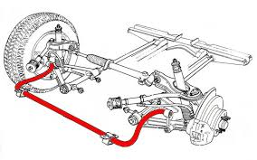
VEHICLE MAINTENACE AND REPAIR
Chapter 16 Suspension system
Main components
Sway Bars (Anti-roll bars): These metal rods connect the left and right suspension components to reduce body roll and keep the car level during turns.
By Ibrahim siraj
Maldives polytechnic

Slide 15
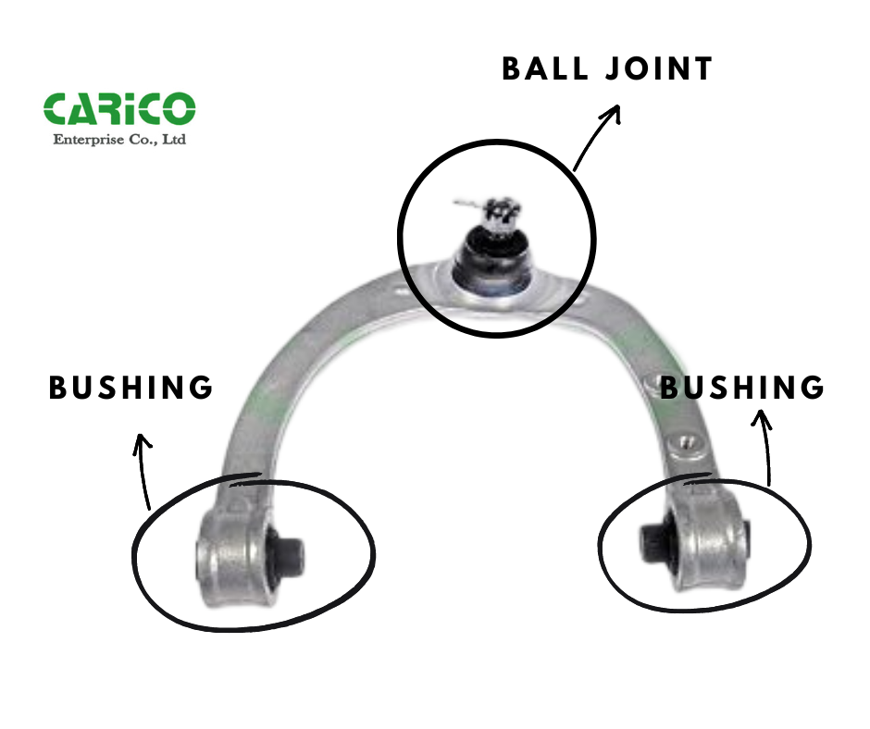
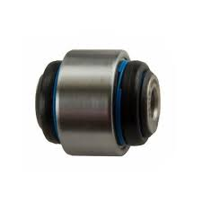
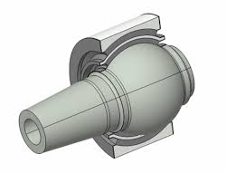
VEHICLE MAINTENACE AND REPAIR
Chapter 16 Suspension system
Main components
Ball Joints and Bushings: These flexible connection points allow components to move smoothly, reduce noise, and absorb minor vibrations
By Ibrahim siraj
Maldives polytechnic

Slide 16
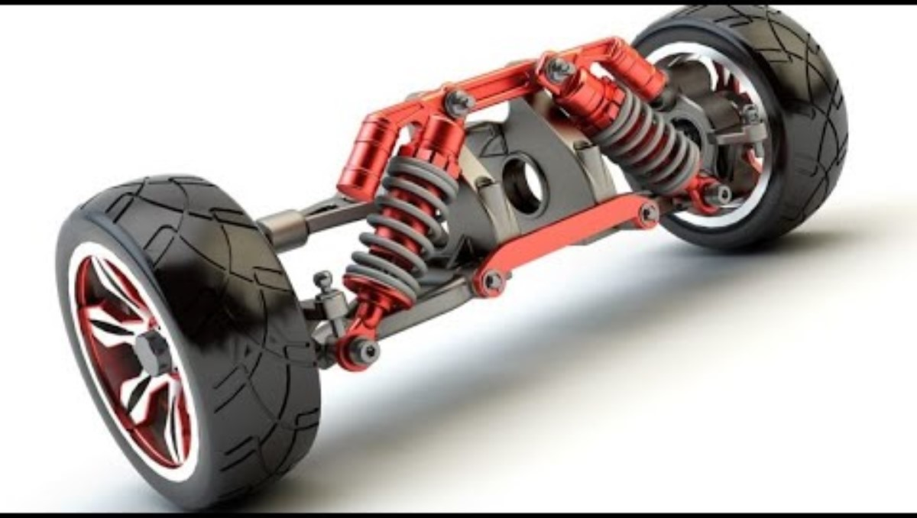
VEHICLE MAINTENACE AND REPAIR
Chapter 16 Suspension system
Introduction
a complex network of parts like springs, shock absorbers, and linkages that connects the vehicle to its wheels.
By Ibrahim siraj
Maldives polytechnic

Slide 17
VEHICLE MAINTENACE AND REPAIR
Chapter 16 Suspension system
Different Types of suspension systems
Suspension systems can be broadly categorized as
dependent, semi-independent
Independent,
MacPherson strut (a type of independent suspension),
Double-wishbone (independent),
Multi-link (independent),
Leaf spring (dependent), and
Air suspension (often independent).
By Ibrahim siraj
Maldives polytechnic

Slide 18
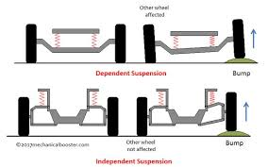
VEHICLE MAINTENACE AND REPAIR
Chapter 16 Suspension system
Different Types of suspension systems
Suspension systems can be broadly categorized as
dependent, semi-independent
Semi-Independent Suspension: This is a compromise between dependent and independent systems, where the wheels on one side are connected to the wheels on the other side, but with some flexibility.
By Ibrahim siraj
Maldives polytechnic

Slide 19
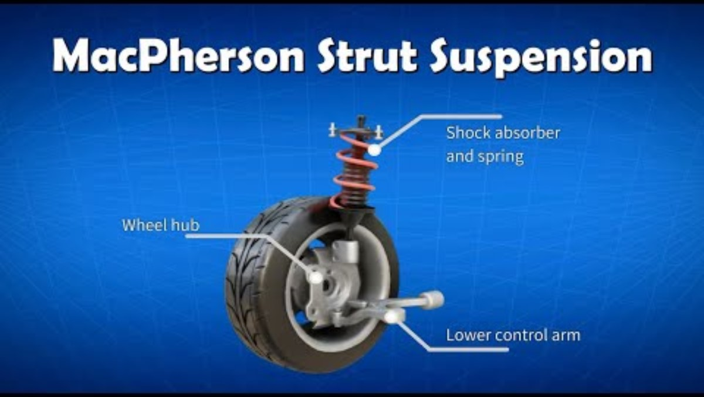
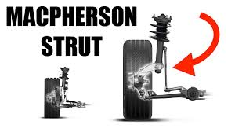
VEHICLE MAINTENACE AND REPAIR
Chapter 16 Suspension system
Different Types of suspension systems
Suspension systems can be broadly categorized as
MacPherson strut (a type of independent suspension),
By Ibrahim siraj
Maldives polytechnic

Slide 20
VEHICLE MAINTENACE AND REPAIR
Chapter 16 Suspension system
Different Types of suspension systems
Suspension systems can be broadly categorized as
Double-wishbone (independent),
an independent suspension system that uses two wishbone-shaped arms to hold each wheel, allowing it to move independently
By Ibrahim siraj
Maldives polytechnic

Slide 21
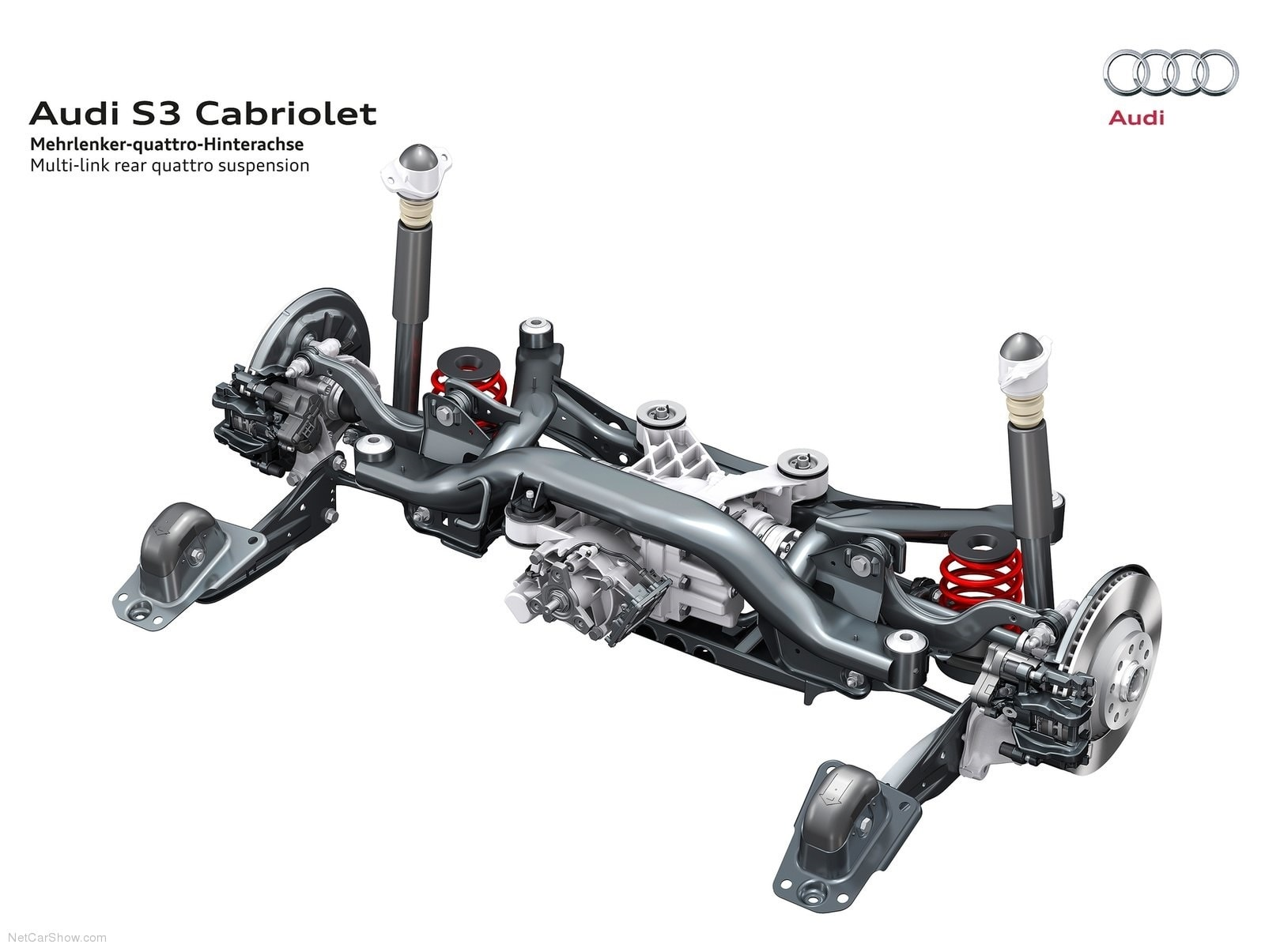
VEHICLE MAINTENACE AND REPAIR
Chapter 16 Suspension system
Different Types of suspension systems
Suspension systems can be broadly categorized as
Multi-link (independent),
An independent vehicle suspension system that uses three or more control links to connect a wheel to the chassis, allowing for a balance between ride comfort and handling. It provides more flexibility for engineers to tune the suspension's characteristics, such as wheel alignment and stability, compared to simpler systems
By Ibrahim siraj
Maldives polytechnic

Slide 22
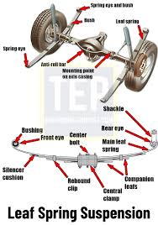
VEHICLE MAINTENACE AND REPAIR
Chapter 16 Suspension system
Different Types of suspension systems
Suspension systems can be broadly categorized as
Leaf spring (dependent), and
a simple, durable vehicle suspension system that uses one or more curved, flexible steel strips ("leaves") to absorb shocks and support the vehicle's weight. This system is commonly found in trucks, trailers, and some SUVs, where its ability to handle heavy loads and withstand rough conditions is beneficial. Leaf springs can be designed for a stiffer ride by using more, thicker leaves or a softer ride with fewer, thinner leaves
By Ibrahim siraj
Maldives polytechnic

Slide 23
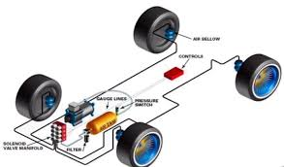
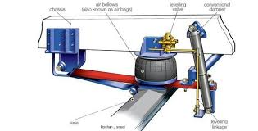
VEHICLE MAINTENACE AND REPAIR
Chapter 16 Suspension system
Different Types of suspension systems
Suspension systems can be broadly categorized as
Air suspension (often independent).
An air suspension system is a vehicle suspension that replaces traditional metal springs with air-filled rubber bellows (air springs) to provide a smoother ride and adjustable ride height.
By Ibrahim siraj
Maldives polytechnic

Slide 24
VEHICLE MAINTENACE AND REPAIR
Chapter 16 Suspension system
Different Types of suspension systems
Suspension systems can be broadly categorized as
Air suspension (often independent).
An air suspension system is a vehicle suspension that replaces traditional metal springs with air-filled rubber bellows (air springs) to provide a smoother ride and adjustable ride height.
By Ibrahim siraj
Maldives polytechnic

Slide 25
THANK YOU

